Slide 1

Cyberbulling Detection
By:
John Hani
Mohamed Nashaat
Mostafa Ahmed
Zeyad Emad
Under supervision of :
Dr. Eslam Amer
Eng. Menna Gamil

Slide 2
Agenda
Introduction
Related work
Problem Statement
System overview
Project Deliverables

Slide 3

Introduction
Psychological:low self-esteem and isolation, perform poorly in school, have few friends in school, have a negative view of school.
Physical:headaches, stomachaches, or problems sleeping.
Mental:depression, suicidal thoughts, and anxiety.

Slide 4
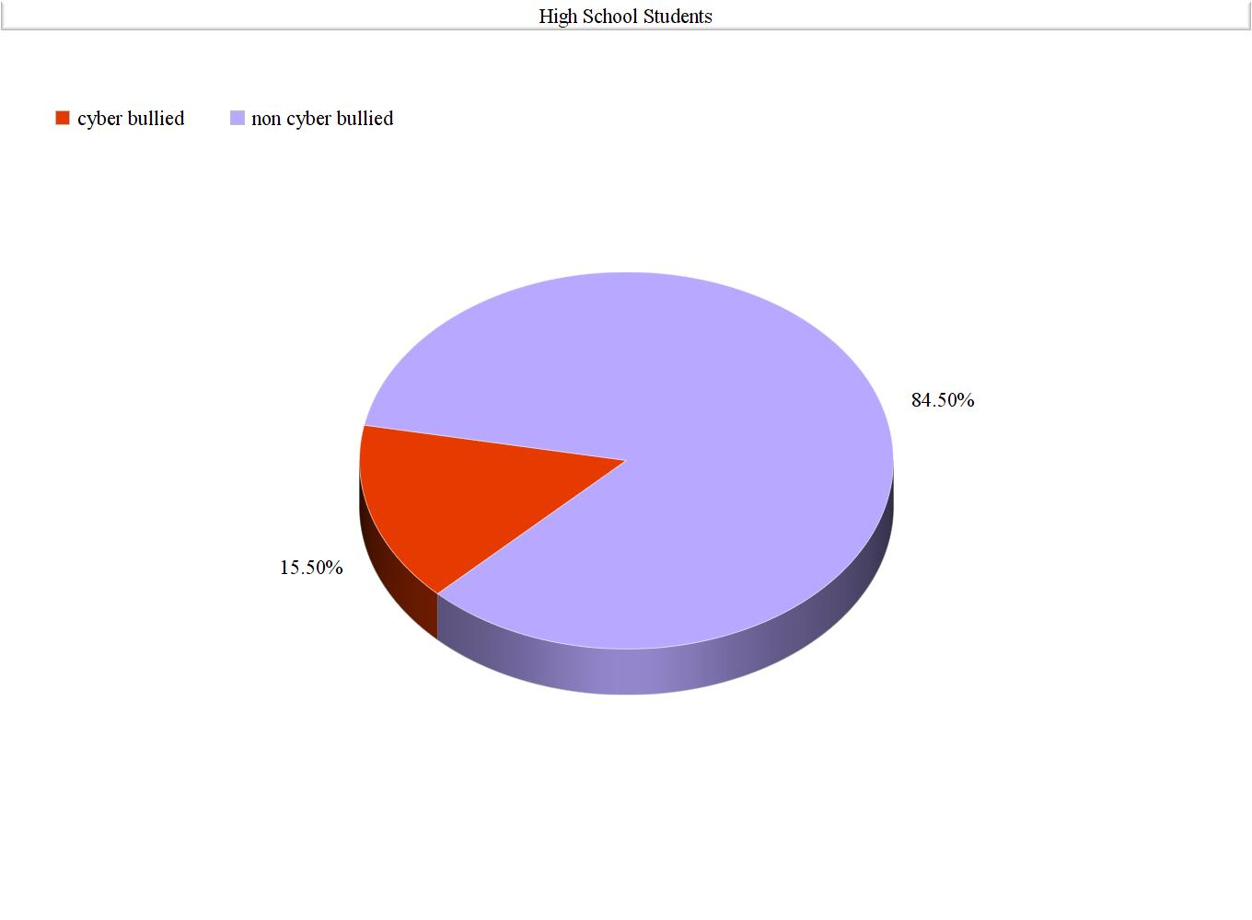
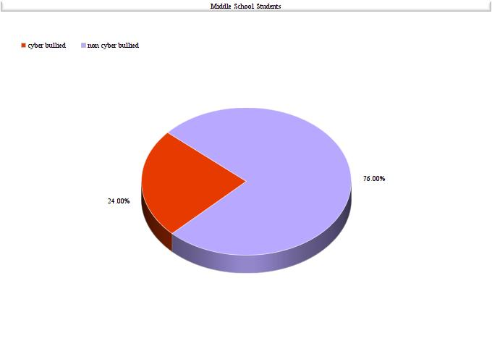
Introduction

Slide 5
Related Work
Proposed Model: Our model will avoid a bag-of-words (BoW) (bully traces) can be pre-filtered using syntactic and semantic analysis, using NLP algorithms also sentiment analysis features.
Syntactic features
Bad words
Bad words density:
Badness of a sentence:
Density of upper case letters:
Exclamations and questions marks:
Semantic features
Bigrams:
Trigrams:
Sentiment features
Sentiment polarity of a sentence:
Emoticons:
Social features
Direct User Tagging
Author profiling:
Messages exchanged with a user:

Slide 6
Problem Statement
Cyberbullying has been manifesting our youth for quite sometime, due to them being involved in one form of social media communication or another. Worst case scenario is self harm and suicide when exposed to too much bullying

Slide 7
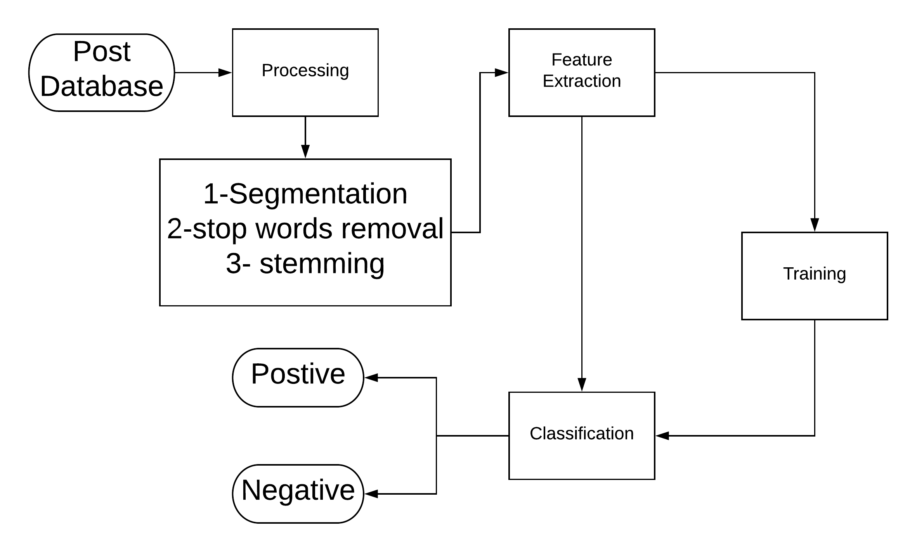
System overview

Slide 8
Input and Preprocessing
-Step 1:We take the posts from database.
-Step 2: Segmentation
-Step 3: Remove Stop words
-Step 4: Stemming of words
-Step 5: Solution for the obfuscation of words

Slide 9
Processing
Sentiment analysis
Context analysis
Deep Learning Classification

Slide 10
Output
-Determination of whether the post is cyberbullying or not.
-Finally, we take steps to prevent this from happening again Like: Alerting Parents and blocking the bully.

Slide 11
4.1 Tasks and Time plan
Task Name | From | To
Idea Discussion | 1/8/2018 | 1/8/2018
Idea Research | 1/8/2018 | 13/9/2018
Proposal Writing | 13/9/2018 | 16/9/2018
Implementing Prototype | 16/9/2018 | 17/9/2018
Delivering Rehearsal | 18/9/2018 | 18/9/2018
Delivering Proposal | 18/9/2018 | 26/9/2018
Doing Survey | 10/10/2018 | 20/10/2018
Implementing Second Prototype | 20/10/2018 | 25/10/2018
Writing SRS | 25/10/2018 | 30/10/2018

Slide 12
4.1 Tasks and Time plan Cont.
Implementing | 30/10/2018 | 25/11/2018
Preparing for External Examiner | 25/11/2018 | 3/12/2018
Implementing | 3/12/2018 | 18/1/2019
Writing SDD | 18/1/2019 | 1/2/2019
Implementing | 1/2/2019 | 1/4/2019
Preparing for Implementation Evaluation | 1/4/2019 | 25/4/2019
Writing 8 Pages Paper | 25/4/2019 | 28/4/2019
Finalizing Implementation | 28/4/2019 | 7/5/2019
Writing Final Thesis | 10/5/2019 | 25/5/2019
Presenting Final Thesis | 25/6/2019 | 25/6/2019

Slide 13
4.2 Budget and Costs $$
No Costs are Needed for this Project up till now

Slide 14
4.3 Supportive Documents
”A Multilingual System for Cyberbully Detection: Arabic Content Detection using Machine Learning” By Batoul Haidar, Maroun Chamoun, Ahmed Serhrouchni.
”Cyberbullying Detection using Time Series Modeling” By Nektaria Potha, Manolis Maragoudakis
”Cybercrime detection in online communications: The experimental case of cyberbullying detection in the Twitter network” By Mohammed Ali Al-garadi , Kasturi Dewi Varathan , Sri Devi Ravana
”Machine Learning Approach for Detection of Cyber-Aggressive Comments by Peers on Social Media Network” By Vikas S Chavan , Shylaja S S
”Machine learning and semantic analysis of in-game chat for cyber bullying” By Shane Murnion , William J Buchanan , Adrian Smales , Gordon Russell
”Unsupervised Cyber Bullying Detection in Social Networks” By Michele Di Capua , Emanuel Di Nardo, Alfredo Petrosino
”Cyberbullying System Detection and Analysis” By Yee Jang Foong , Mourad Oussalah

Slide 15
Any Questions?

